Slide 1
Who Should You Trust
By: Mr. K

Slide 2
Should we trust this guy?
.com and .net

Slide 3
This might be a little better….
.org
.int

Slide 4
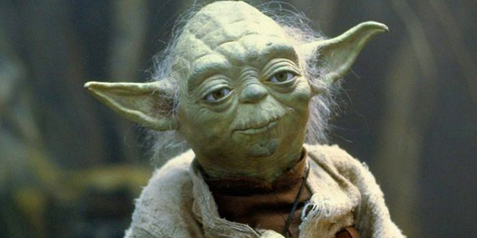
Still, a little better…
.mil

Slide 5
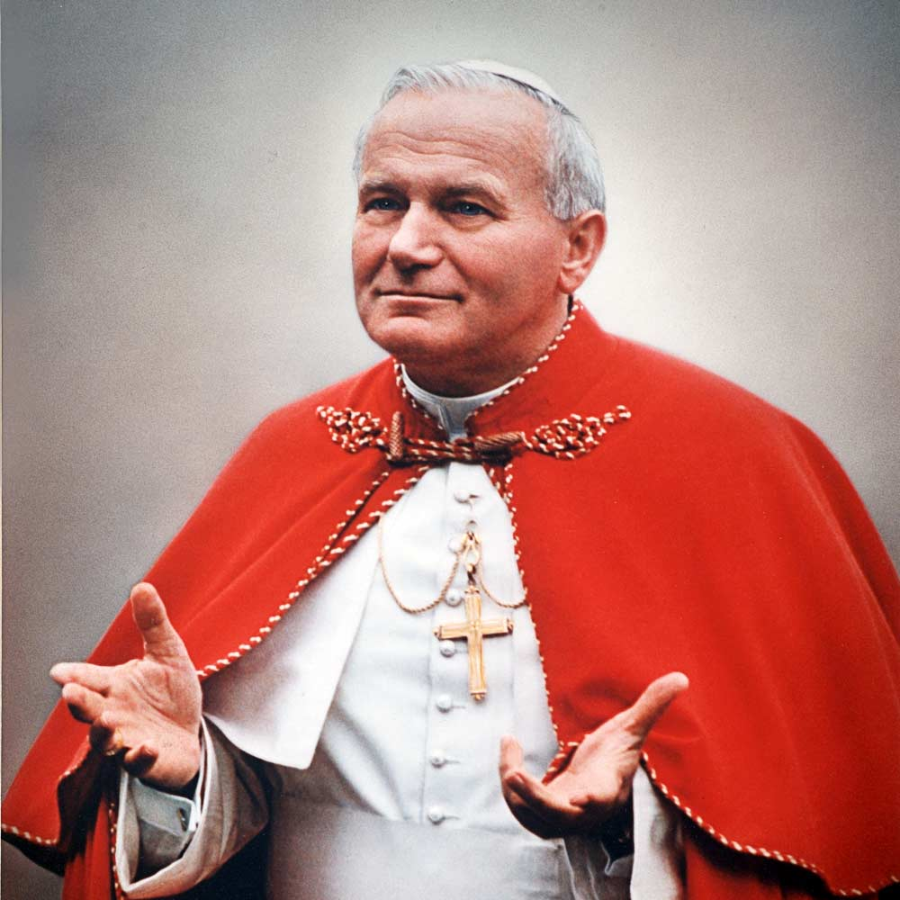
Much better….
.edu
.gov

